Slide 1


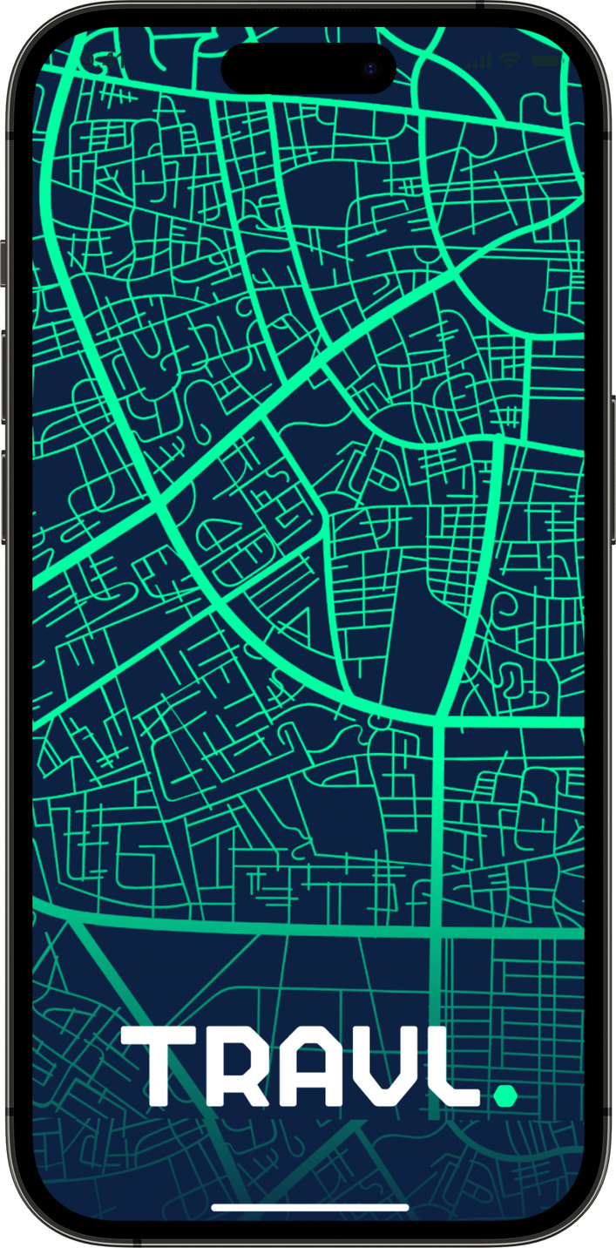
Where Do I Stay?.
MSDS 2025 Hackathon

Slide 2
Sources of Data
HomeHarvest GitHub Page (for fetching properties from Realtor.com in CSV format)
Seattle Police Department Data (public) (for Crime Information)
Seattle Parks and Recreation Park Addresses (public) (for creating custom functions to find the closest parks)
Paid Parking Transaction Data (public) (for creating custom functions to find the nearest parking spots as well as the parking rates)

Slide 3
Preparation of the Data
Generated zip codes from neighborhood data. Created 83 zip-codes from 58 instances of neighborhood data.
Clustered locations by their proximity to light-rail (created 24 clusters from over 1800 locations)
Merged three columns in the data-source to create one value of price / rent. These columns were normal, min_price, max_price
Identified methods to calculate per-capita census crimes.
Created methods to calculate the closest park, metro, parking spot for every location
Joined the public and private tables mentioned in previous slide and cleaned the outcome table by removing redundant columns and nulls.

Slide 4

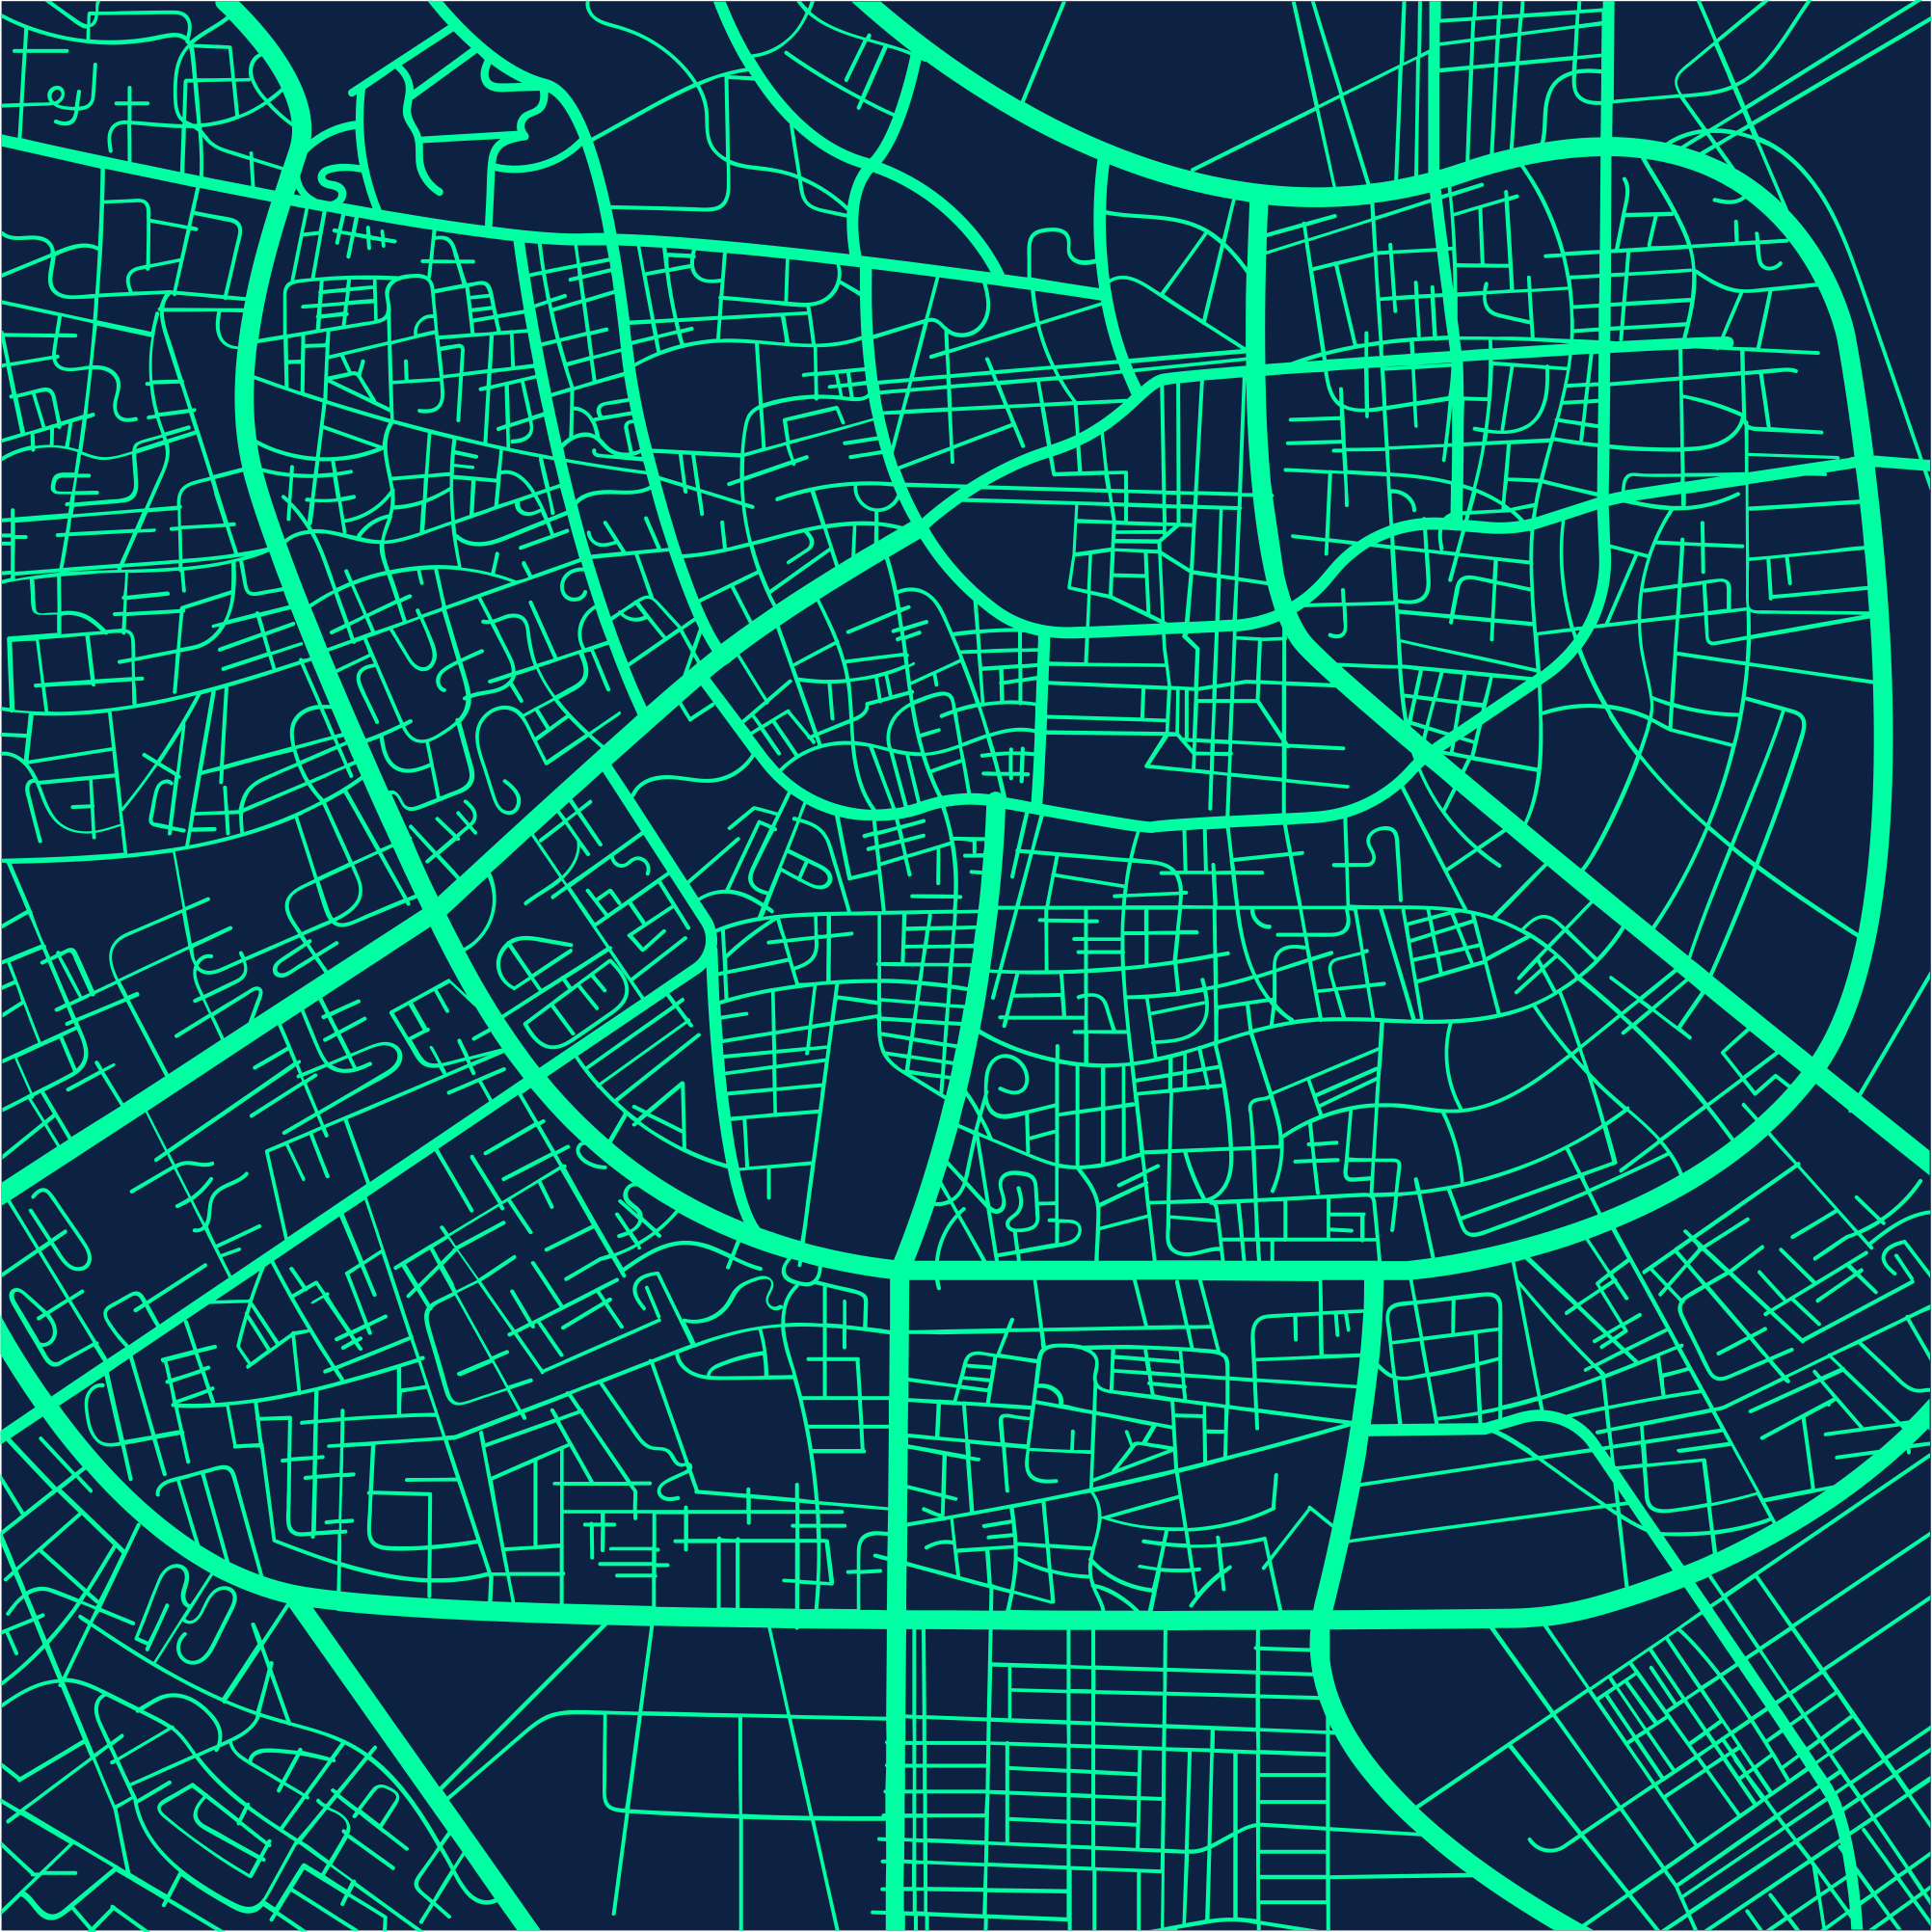
SOFTWARE
STACK

Slide 5

Streamlit
Allows us to create interactive dashboards
Integrates with other data visualization libraries
Allows deployment of, and interaction with machine learning models directly from the app.
Allows user interaction through widgets like sliders, buttons, dropdowns etc.
Works with geospatial tools like folium.
Put a screenrecording of using the app and choosing various filters here

Slide 6

Folium
Allows us to create interactive maps with zoom, pan, and customizable map layers.
Display data points (coordinates, addresses) on a map with markers and clusters.
Allows customizability of markers with colors, icons, and popups
Allows us to use GeoJSON to represent geographic boundaries such as city limits, administrative divisions.
Put a screen-recording of clicking on the map and choosing various filters here

Slide 7

Scikit-Learn
Enabled us to clean, transform, and prepare the data for machine learning through inbuilt functions of scaling, handling missing data, feature selection, and more.
Helped us perform supervised machine learning and create a cost-model.
Its feature engineering methods helped us perform feature scaling, normalization, and overall improve model performance.
Industry-standard and integrates well with pandas, NumPy, Matplotlib, Jupyter Notebooks etc.
Put a screen-recording of the model working / some screenshot of the model’s output here

Slide 8

WORKING DEMO

Slide 9







Several Factors could impact your choice
Distance
Amenities
Public Transport
Safety
Recreation
Nature of Housing

Slide 10
Now, Some MACHINE LEARNING

Slide 11
Machine Learning Tasks and Outcomes (Copy this slide if needed to show multiple pages of charts. Use one chart per page for better communication)
Task
Outcome text and graphs go here
Outcome text and graphs go here
Outcome text and graphs go here

Slide 12
Color Palette
Green
Dark blue
#00ffa3
rgb(0, 255, 163)
hsl(158, 100%, 50%)
cmyk(100%, 0%, 36%, 0%)
#0d2243
rgb(13, 34, 67)
hsl(217, 68%, 16%)
cmyk(81%, 49%, 0%, 74%)
Offwhite
#f5f5f7
rgb(245, 245, 247)
hsl(240, 11%, 96%)
cmyk(1%, 1%, 0%, 3%)
White
Blue grey
#ffffff
rgb(255, 255, 255)
hsl(0, 0%, 100%)
cmyk(0%, 0%, 0%, 0%)
#98a1af
rgb(152, 161, 175)
hsl(217, 13%, 64%)
cmyk(13%, 8%, 0%, 31%)

